Slide 1
Zoom games – Ideation and low-fidelity prototypes
Embrace the Chaos – Sarah Johnson, Ethan Kohrt, Jake LaMotte, Boone Tison

Slide 2
Introduction / background
Previous phase gave idea of what features people wanted
Short minigames, about 2-3 minutes
3-5 people
Discreet, non-disruptive games, temporary distraction
Social games that are main focus
Jake

Slide 3
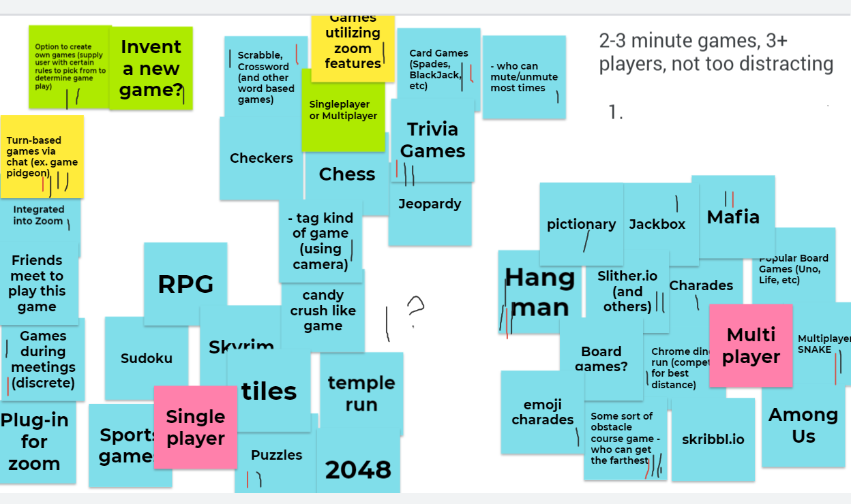
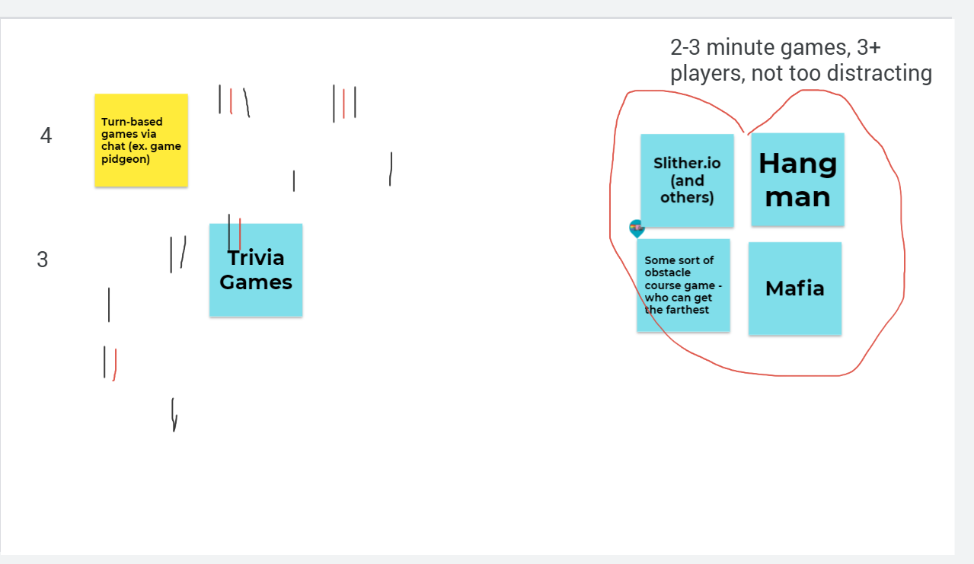
Brainstorming
Used ideas from interviews and our own
Fit at least one of the features determined by data collection
Voted to 6 games then 4
Slither.io
Hangman
Obstacle Course
Mafia
Boone

Slide 4
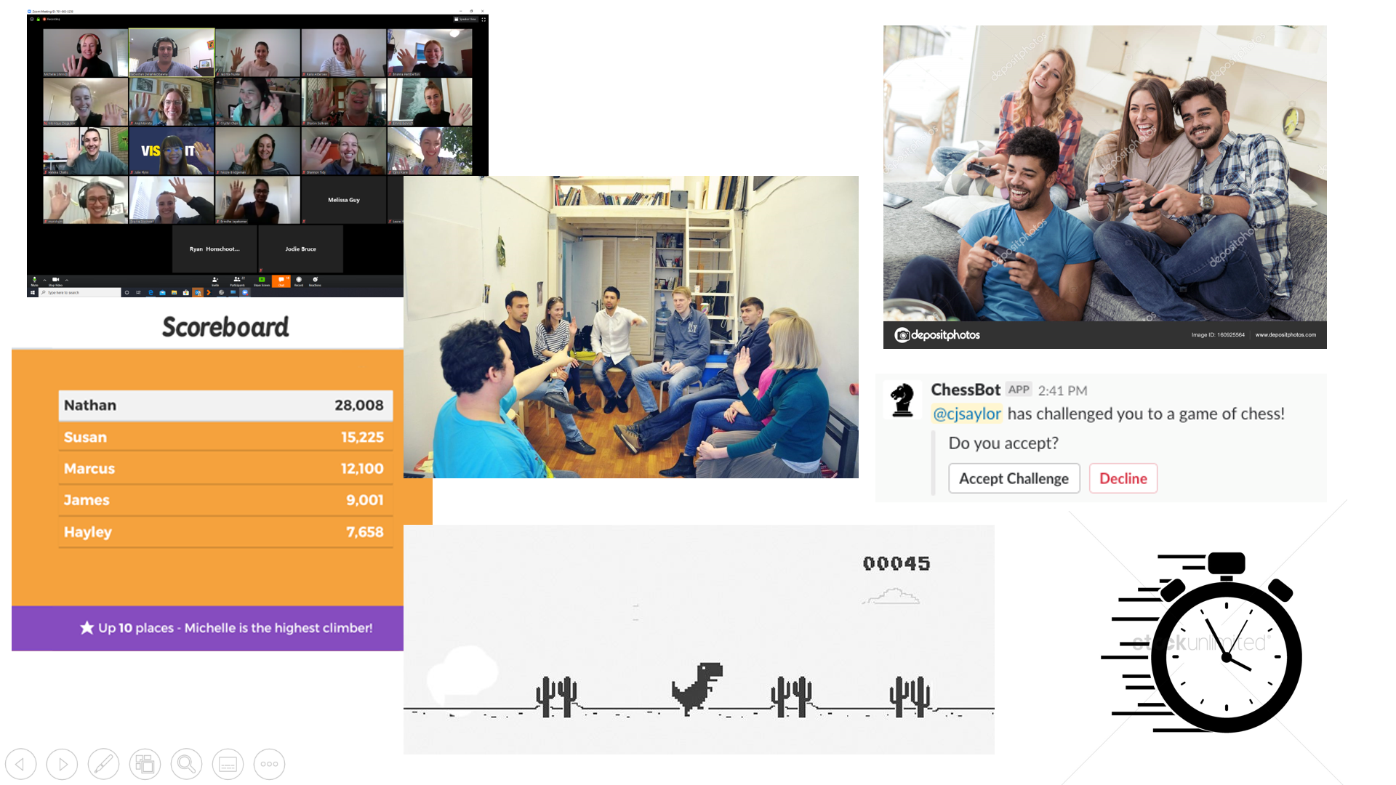
Mood board / use case
Mood board
Socialization among friends
Competitive atmosphere
Use Cases
Chat–based game
Multiplayer on main view
Sarah

Slide 5
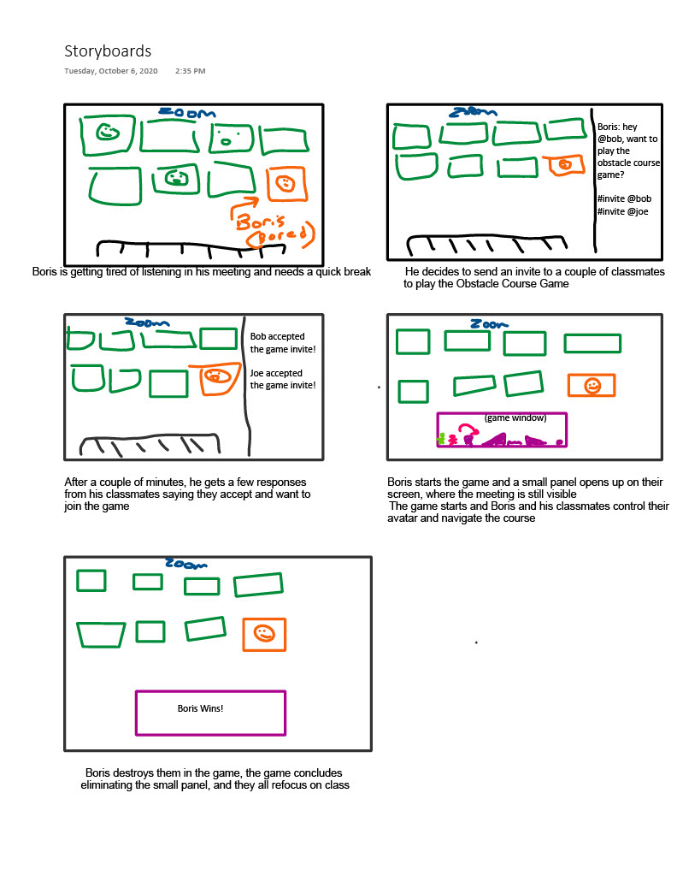
Personas / scenarios / storyboard
Personas
Sasha – socializing with friends
Boris – bored, wants small distraction
Reid – checked out, wants something else to do
Scenarios
Boris playing obstacle course, Hangman
Sasha playing Mafia
Reid playing Slither.io
Ethan

Slide 6
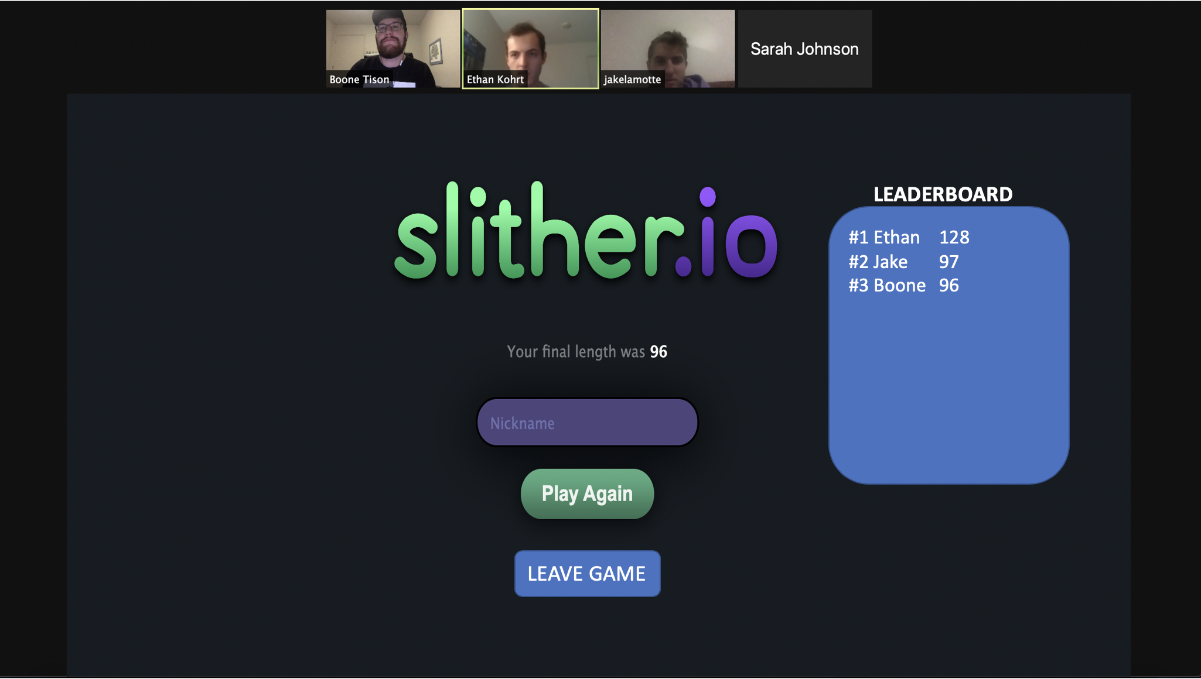
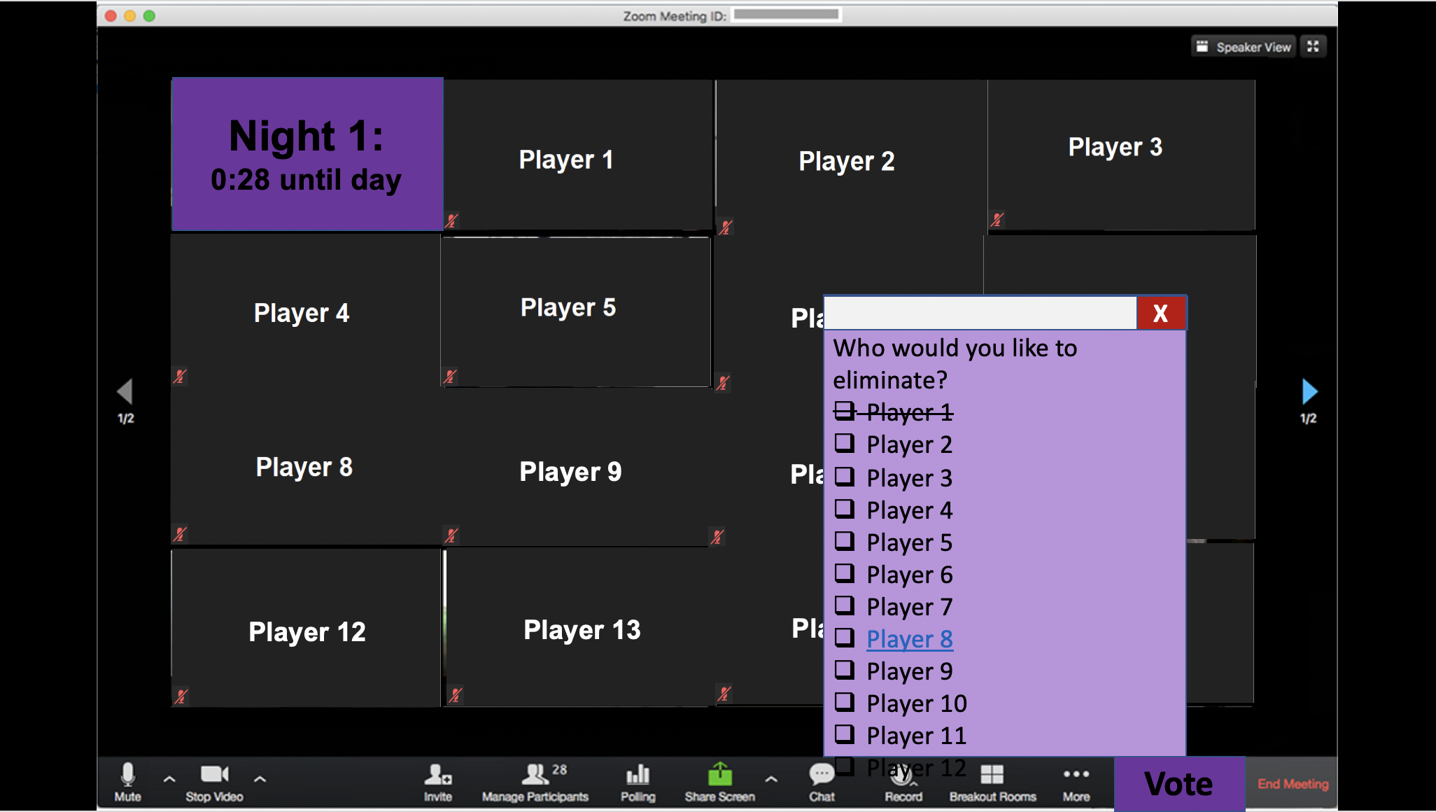
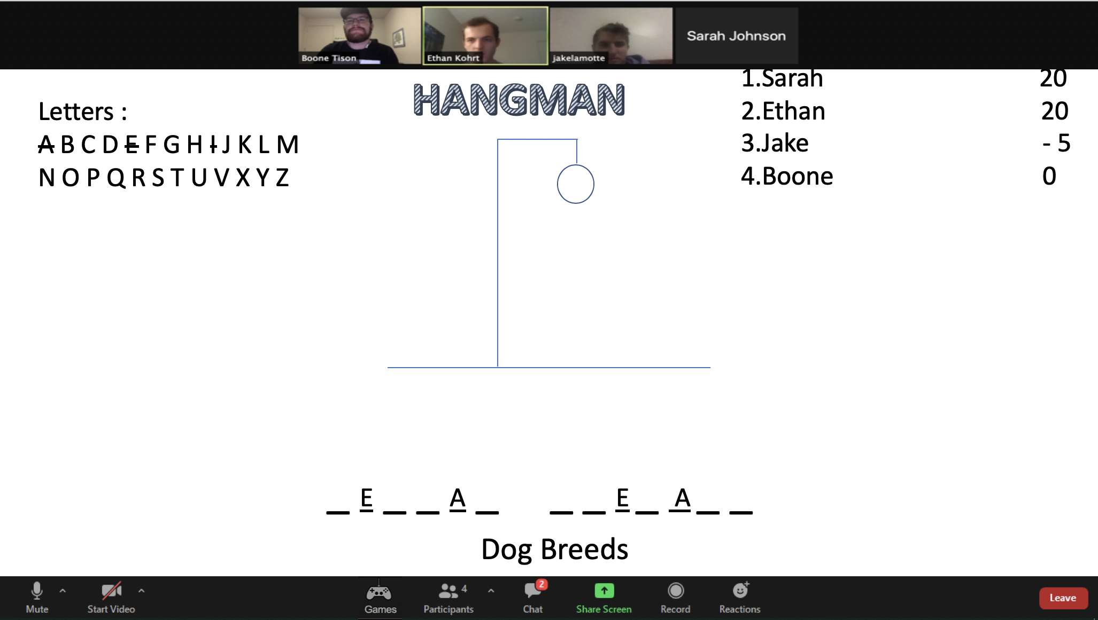
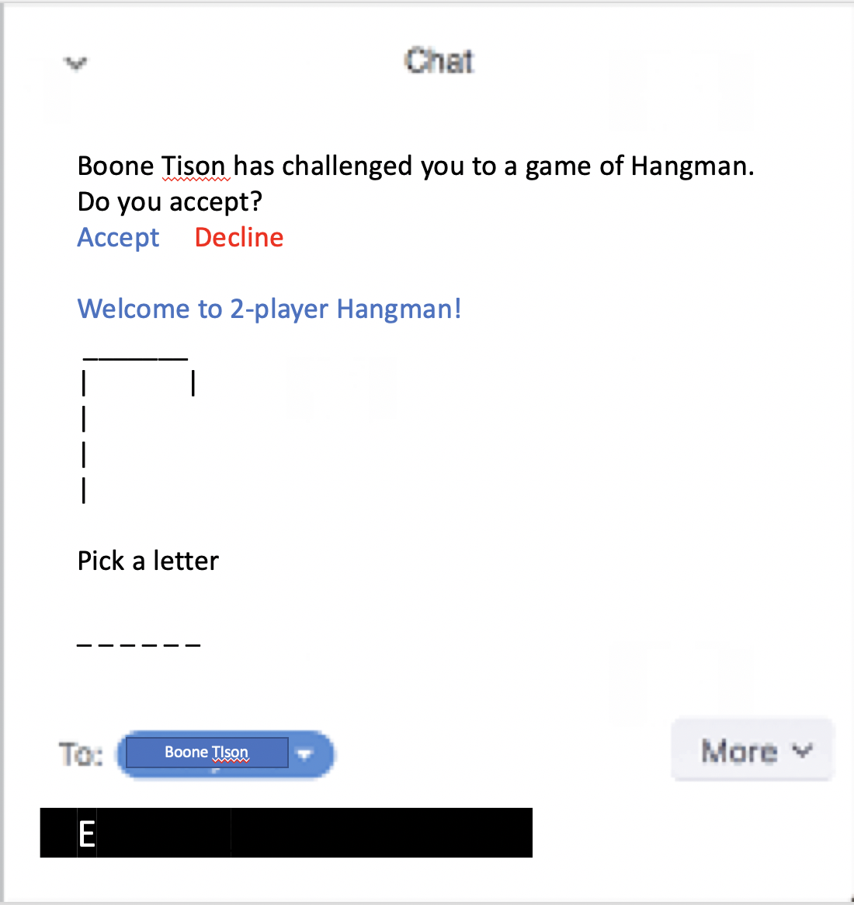
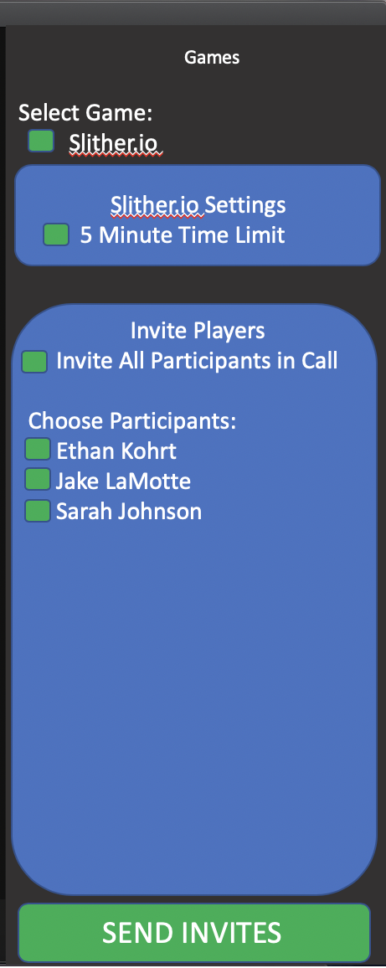
prototypes
Boone

Slide 7
user study
5 participants
Questions
What games they liked and disliked
What features they liked and disliked
Features to add or improve
Sarah

Slide 8
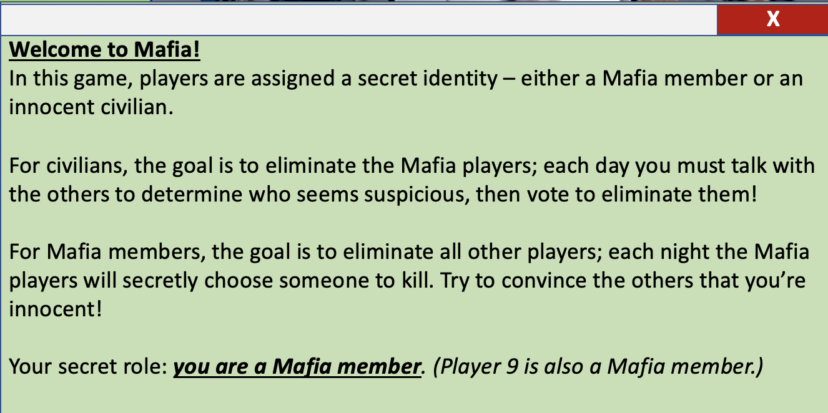
Analysis / results
Hangman
Chat-based version more popular
Some felt it was monotonous
Unclear goal
Slither.io
Simple interface, some parts lacked context
Some said it was boring, but easy enough to play during a meeting
Mafia
Needs better tutorial
Best for purely socializing
Ethan

Slide 9
Discussion / conclusion
Majority of feedback was positive
High interest in chat-based, better suited for meetings
Interest in games not easily playable on internet, like Mafia
Prototypes were interactive and enjoyable
Jake

